Slide 1

®
HEALTH SCIENCES CENTER
The UNIVERSITY of OKLAHOMA
go2.ouhsc.edu

Slide 2
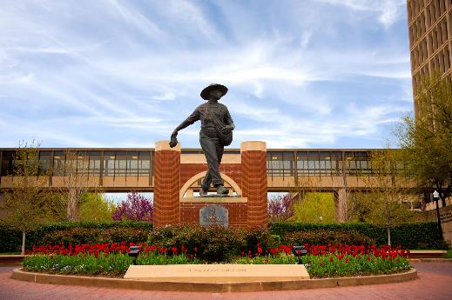
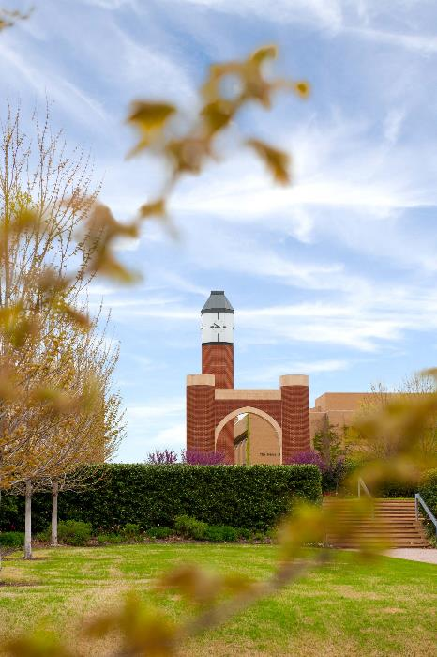
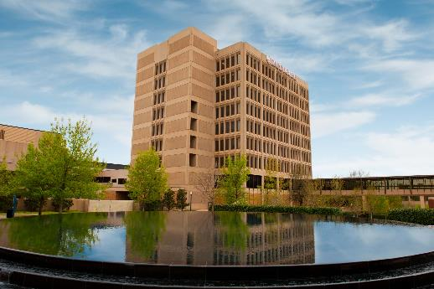
The University of Oklahoma Health Sciences Center is one of only a few comprehensive health centers in the nation with seven health professional Colleges.
go2.ouhsc.edu

Slide 3

OUHSC
The OUHSC is the cornerstone of the Oklahoma Health Center, nestled among OU Medical, The Children’s Hospital, Harold Hamm Oklahoma Diabetes Center, Peggy & Charles Stephenson Cancer Center, OU Physicians, and Oklahoma Medical Research Foundation.
      94
      Health professions, undergraduate and graduate degrees
      3238
      Students Enrollment
      1278
      Full-time Faculty
      300
      Acre Campus
      25
      Miles north of Norman, OK
®
The UNIVERSITY of OKLAHOMA | go2.ouhsc.edu

Slide 4
Demographics
OVERALL ENROLLMENT
OUHSC Total
3238
In-State
2573
Out-of-State
665
The UNIVERSITY of OKLAHOMA | go2.ouhsc.edu
®

Slide 5
Demographics
TOTAL COUNTRIES OF ORIGIN: 173
The UNIVERSITY of OKLAHOMA | go2.ouhsc.edu
®

Slide 6
Enrollment
TOTAL BY COLLEGE
Medicine 876
Nursing 728
Allied Health 638
Pharmacy 238
Dentistry 330
Graduate College 288
Public Health 103
Intercampus 28
The UNIVERSITY of OKLAHOMA | go2.ouhsc.edu
®

Slide 7
Enrollment
UNDERGRADUATE PROGRAMS
College of Allied Health
Communication Sciences & Disorders
Nuclear Medicine
Radiography
Sonography
College of Dentistry
Dental Hygiene
College of Nursing
Bachelor’s of Science in Nursing
Nursing 584
Allied Health 176
Dentistry 93
The UNIVERSITY of OKLAHOMA | go2.ouhsc.edu
®

Slide 8
Parallel Planning
What should my major be?
Lets talk you…
What am I passionate about?
When do I feel my best?
What are you good at? Do you see trends?
When are you proud of yourself?
Tell me about your values and interests?
Lets talk you 2.0…
The strength of your academic record?
Looking at sciences courses, how do you feel?
How competitive are the programs?
The UNIVERSITY of OKLAHOMA | go2.ouhsc.edu
®

Slide 9
Shadowing
How do I decided on a program?
Due to the risks associated with COVID-19, our hospital partners are unable to accommodate students interested in shadowing.
So, what’s next? Virtual Shadowing!
HSC Student Affairs is offering virtual shadowing opportunities.
We will notify you of scheduled events to share with students.
Stay tuned at https://students.ouhsc.edu/prospective-students
In the meantime, prospective students are encouraged to reach out to local clinics for shadowing opportunities.
The UNIVERSITY of OKLAHOMA | go2.ouhsc.edu
®

Slide 10

OUHSC Degrees
DEGREE SHEETS
www.ouhsc.edu
Future Students
Degrees Offered
(students.ouhsc.edu/ProspectiveStudents/DegreesOffered.aspx)
The UNIVERSITY of OKLAHOMA | go2.ouhsc.edu
®

Slide 11
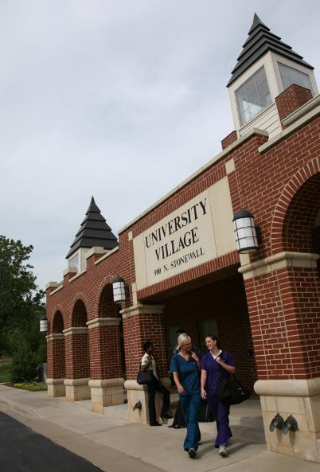
University Village
RENT
Studio Apartments | $642
Townhouse | $995 ($497.50 Half)
Rent includes water, trash and sewer service, security alarm, and high-speed internet.
AMENITIES
Gated Community, Laundry Facilities, Security
System and Internet Connection in each room
The UNIVERSITY of OKLAHOMA | go2.ouhsc.edu
®

Slide 12
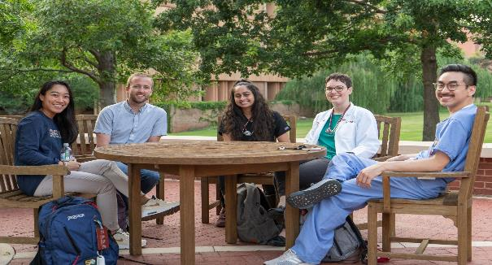
Contact Us
HSC Student Affairs | 1106 Stonewall Avenue, Suite 300
Oklahoma City, Oklahoma 73117
Phone: 405.271.2416 | Toll-Free: 1.877.577.5655
students@ouhsc.edu
The UNIVERSITY of OKLAHOMA | go2.ouhsc.edu
®

Slide 13
HEALTH SCIENCES CENTER
The UNIVERSITY of OKLAHOMA
go2.ouhsc.edu
hscstudent
students@ouhsc.edu
@hscstudent
(405) 271-2416
OU Health Sciences Center

