Slide 1
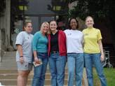
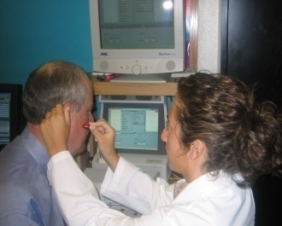
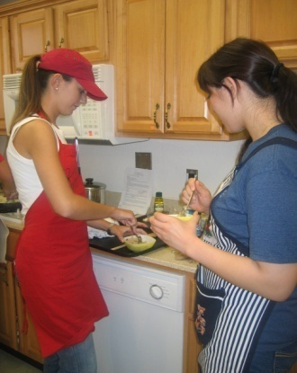
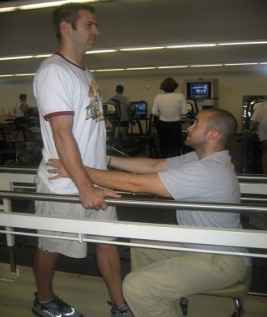
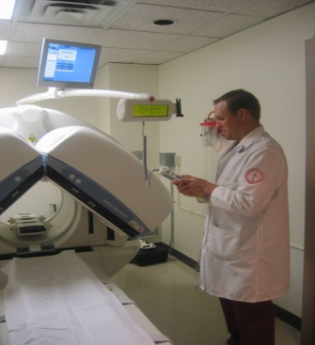

College of Allied Health
alliedhealth.ouhsc.edu
We Empower Life!
The University of Oklahoma Health Sciences Center
Notes:
Review packet materials: Announcements, CAH Summary “slick”, Open House flyer, copy of slides.

Slide 2
Susan B. Tucker, MPH, OTR/L, FAOTA
Assistant Dean for Student Affairs
Assistant Professor
susan-tucker@ouhsc.edu
405.271.6588
Paije Fauser, BA
Director for Student Services (OKC)
paije-fauser@ouhsc.edu
405.271.6588
Kyle Miller Shawnee, BA
Recruiting Specialist (Tulsa)
kyle.miller@ou.edu
918.660.3318

Slide 3

Thank you!
Notes:
You are the front line --- and we thank you.

Slide 4
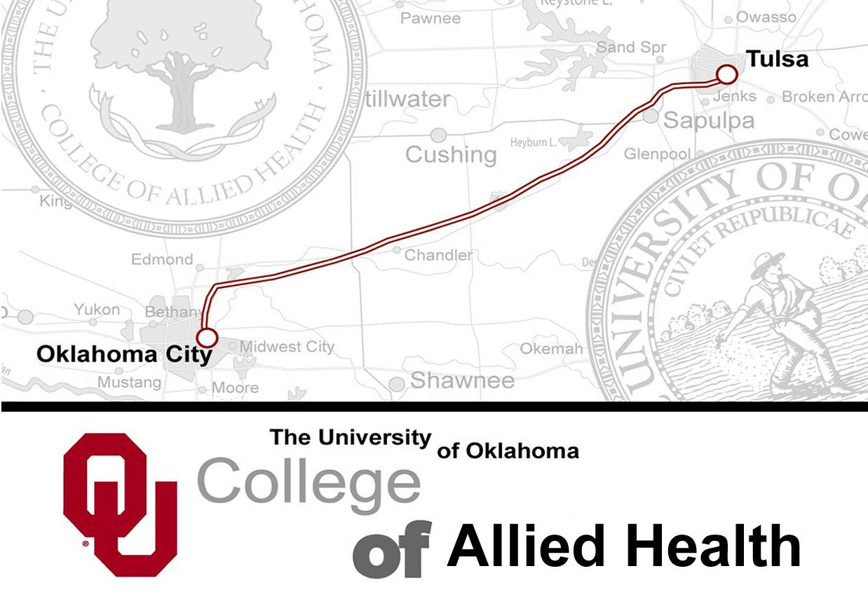
Notes:
The College of Allied Health is one great college offering programs on 2 campuses. We offer occupational therapy, physical therapy, and sonography on the Tulsa campus as well as the Master of Science in Nutritional Sciences.

Slide 5
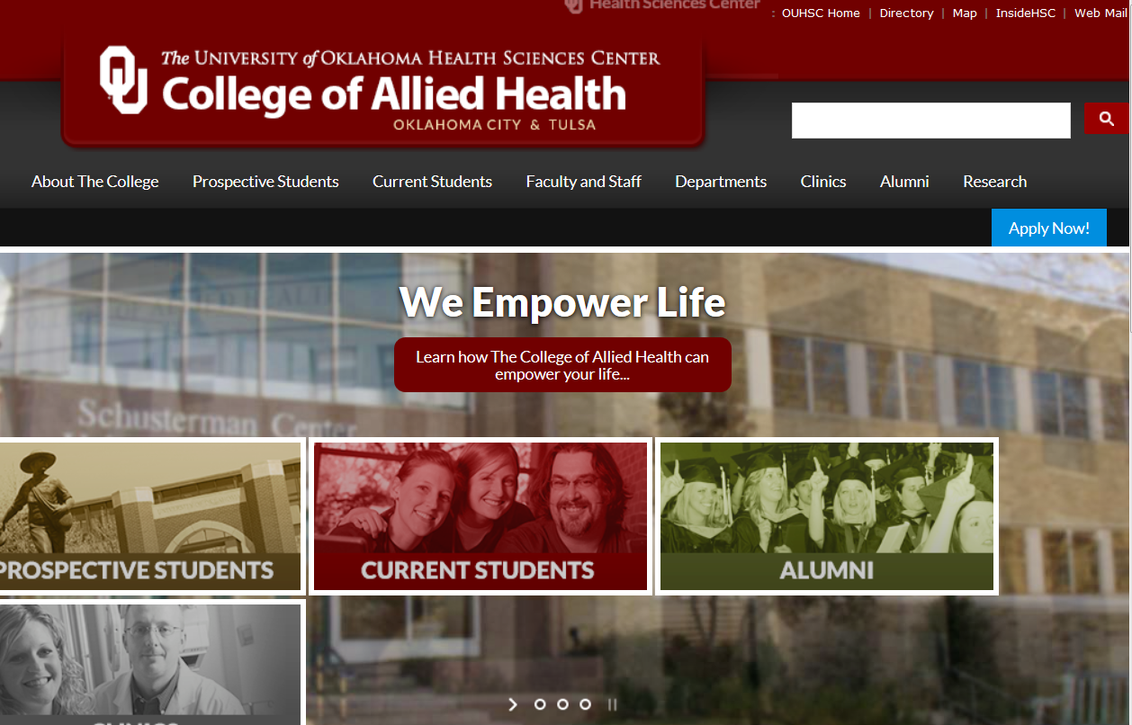
alliedhealth.ouhsc.edu
Notes:
Our Website is your most up-to-date link for advisement information. Useful information for prospective students and counselors/advisors. The transfer equivalency database is critical for identifying courses that will transfer.

Slide 6
Demand
Fastest Growing Occupations - USA
2016 - 2026
  Physical Therapists 28% change
  Occupational Therapists 24% change
  Audiologists 21% change
  Speech-Language Pathologists 18% change
  Sonographers 17% change
  Dietitians 15% change
  Radiation Therapists 13% change
  Radiographers 13% change
  Nuclear Medicine Technologists 10% change
U.S. Department of Labor Statistics
www.bls.gov
Notes:
The allied health fields continue to be in the “fastest growing” occupations list according to US Department of Labor. In this time of economic uncertainty, our prospective students can have confidence that the allied health professions will continue to be in high demand.

Slide 7
Salary
USA - mean annual estimates
Audiologist $75,920
Dietitian $60,370
Nuclear Medicine Technologist $76,820
Occupational Therapist $84,270
Physical Therapist $87,930
Radiation Therapist $82,330
Radiographer $61,240
Sonographer $67,080
Speech-Language Pathologist $77,510
U.S. Department of Labor Statistics
www.bls.gov

Slide 8
Education
Notes:
One of the attractions about the allied health professions is that the training varies – bachelor programs, masters programs, and doctorate programs.

Slide 9
Admission Requirements
Prerequisites
  Symbolic & Oral Communication
  Natural Sciences
  Social Sciences
Minimum gpa
  2.5 or 2.75 or 3.0
OT & PT: 40 hours of observation experience
OT, PT, Audiology, Speech-Language Pathology/Graduate: GRE General Test
Notes:
Overview of admission requirements … detail is on the website.

Slide 10
Application Procedure
DEADLINES
February 1: AuD, NS, OT, PT, SLP
March 1: CSD, MIRS
Various dates (see website): Grad level programs
APPLICATION
http://alliedhealth.ouhsc.edu/ProspectiveStudents/ApplyingtoaProgram.aspx
$100.00 application fee ($50 OUHSC & $50 CAH)
OT & PT: Centralized Application Service
Official, sealed transcripts
Career goal statement
Observation (OT & PT)
List of 3 references/letters (some programs)

Slide 11
Applicant Pool 2019
Program | Applied | Admitted
Communication Sciences & Disorders – BS | 41 | 33
Speech-Language Pathology – MA | 129 | 21
Audiology – AuD | 33 | 6
Nuclear Medicine – BS | 14 | 10
Radiation Therapy – BS | 17 | 10
Radiography – BS | 21 | 13
Sonography – BS | 48 | 24
Dietetics – MA | 32 | 21
Nutritional Sciences – MS | 20 | 13
Occupational Therapy – MOT | 155 | 35
Physical Therapy – DPT | 603 | 63

Slide 12
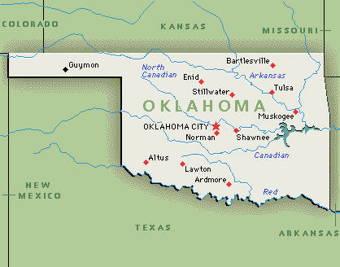
2019 Admitted Students
80% are Oklahoma residents
20% are non-Oklahoma residents
Notes:
Provide information about where our students are from …
Note to self: run query OU_AH_ENROLLED_BY_TERM

Slide 13
Department of Communication Sciences and Disorders
Program | Average cum gpa | Average GRE
Communication Sciences – BS (33) | 3.60 | NA
Audiology – AuD (6) | 3.91 | 303/4.0
Speech-Language Path – MA (21) | 3.87 | 300/4.0
Suzanne Kimball

Slide 14
Department of Medical Imaging and Radiation Sciences
Program | Average cum gpa | Average sci gpa
Nuclear Medicine – BS (10) | 2.99 | 2.51
Radiation Therapy – BS (10) | 3.42 | 2.95
Radiography – BS (13) | 3.25 | 2.94
Sonography – BS (24) | 3.69 | 3.52
Marissa Mangrum

Slide 15
Department of Nutritional Sciences
Program | Average cum gpa | Average sci gpa
Dietetics – MA (21) | 3.52 | 3.22
Nutritional Sciences – MS (13) | 3.56 | 3.16
Leah Hoffman

Slide 16
Department of Rehabilitation Sciences
Program | Average cum gpa | Average sci gpa | Average GRE
Occupational Therapy – MOT (35) | 3.66 | 3.32 | 299/3.9
Physical Therapy – DPT (63) | 3.79 | 3.54 | 302/4.0
Vince Lepak

Slide 17
Questions/Discussion
Notes:
In summary – all allied health fields offer a variety of exciting careers … all of which are in high demand.

