Slide 1
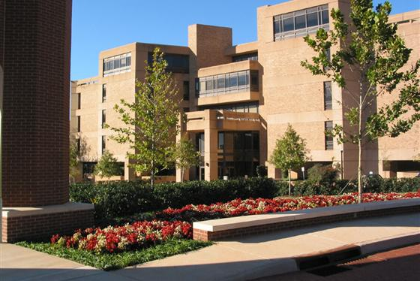
The University of Oklahoma College of Dentistry Dental Hygiene Program
Donna F. Wood, RDH, BSDH, MS
Dental Hygiene Program Director
Associate Professor, College of Dentistry

Slide 2
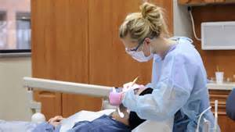
Dental Hygienist
Licensed Healthcare Professional
Focus on preventive, educational, and therapeutic services to promote patients’ oral health/total health
Works closely with the dentist and other healthcare team members to meet oral health needs of patients
Range of services varies from state to state

Slide 3
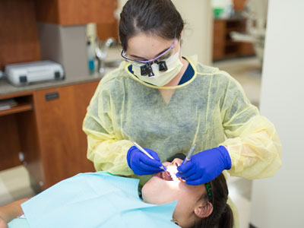
Occupational Outlook
Employment prospects are expected to remain excellent
Ever-growing demand for dental care
2018 Mean Hourly Wage Nationally was $36.30
2018 Mean Hourly Wage
in Oklahoma was $35.57
U.S Bureau of Labor Statistics
National Average – Full-Time Employment
Hourly Wage | $34.19
Annual Salary | $71, 110

Slide 4
Career Advantages
Personal Satisfaction
Variety
Creativity
Flexibility
Career - life balance
Competitive Salary
Advanced Degree

Slide 5
Career Opportunities
Clinical Practice
Corporate
Pharmaceutical sales
Dental Office Manager
Corporate Educator
Hospital/Long-Term Care Consultant
Education
Classroom/Clinic Instructor
Educational Researcher
Program Director
Dean
Public Health
Local/State Dental Public Health Officer
Community Clinic Administrator
National Health Service Corps

Slide 6
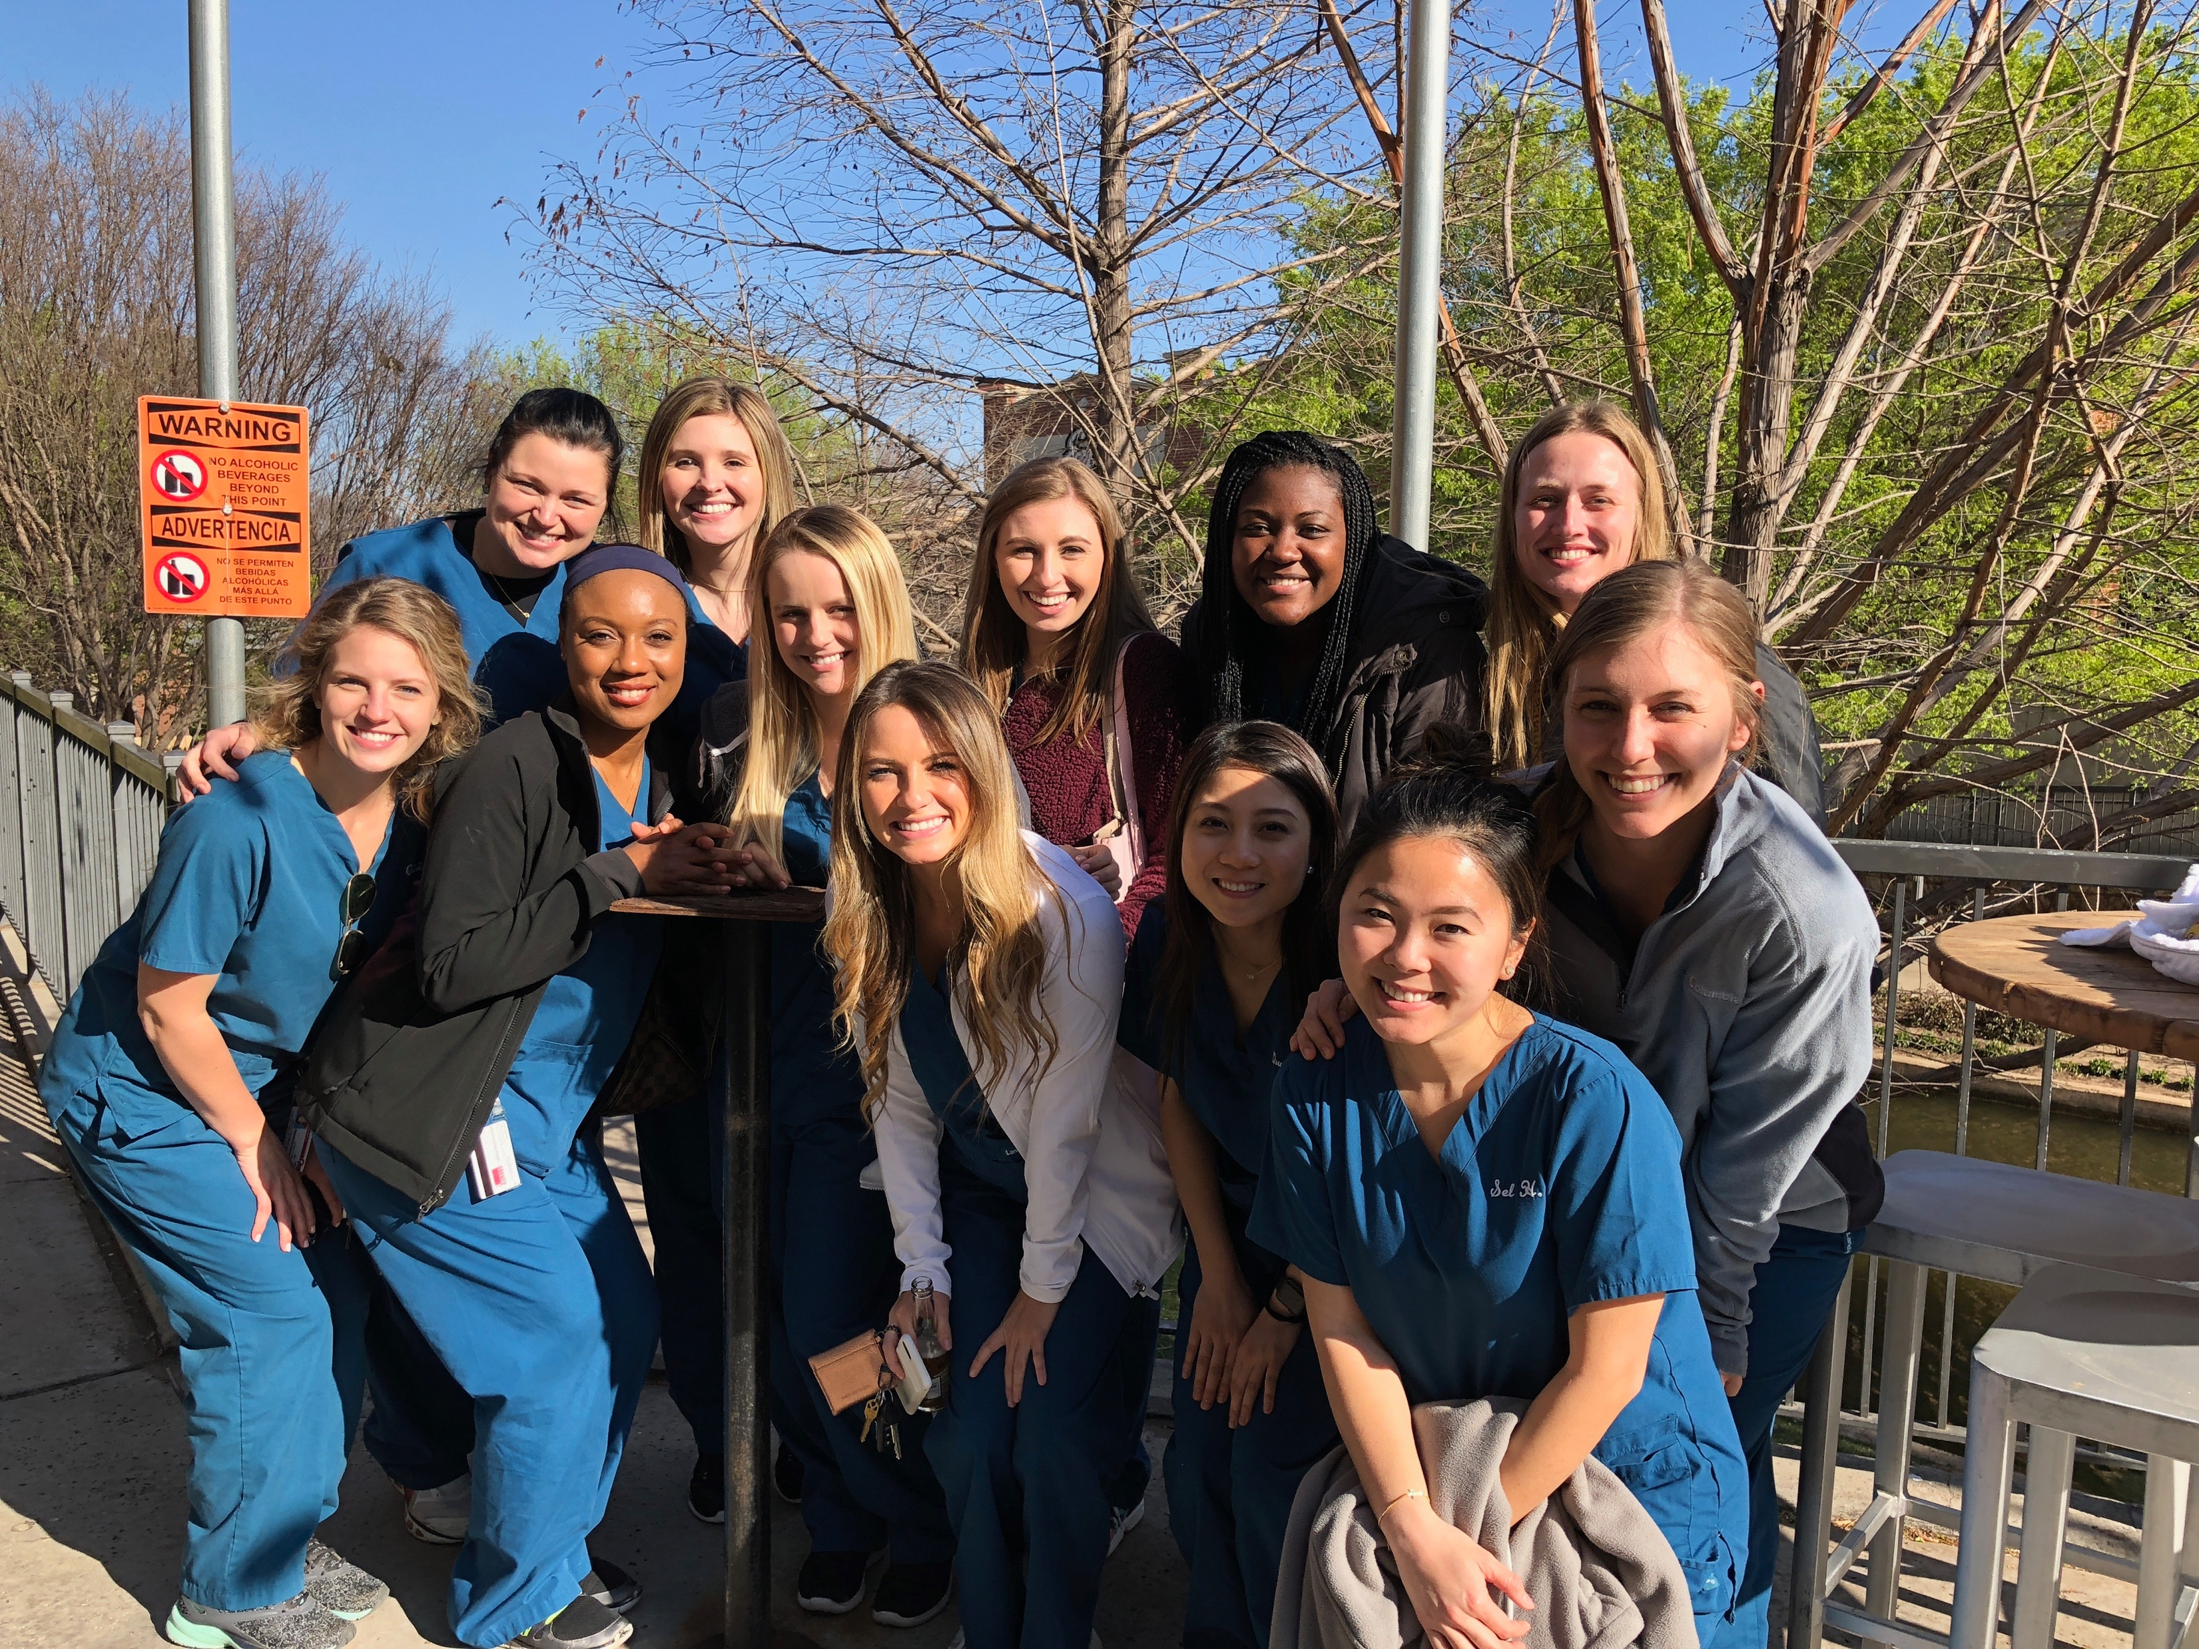
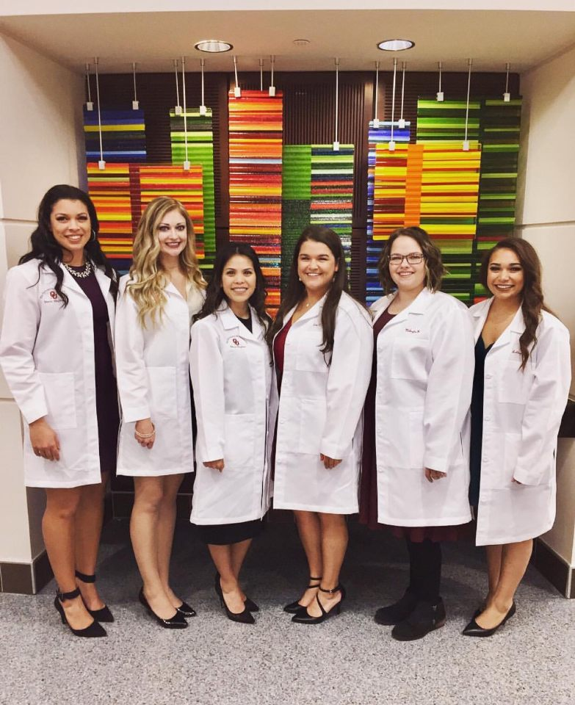
OUHSC OKC 24 students/year

Slide 7
DISTANCE EDUCATION PROGRAM

Slide 8
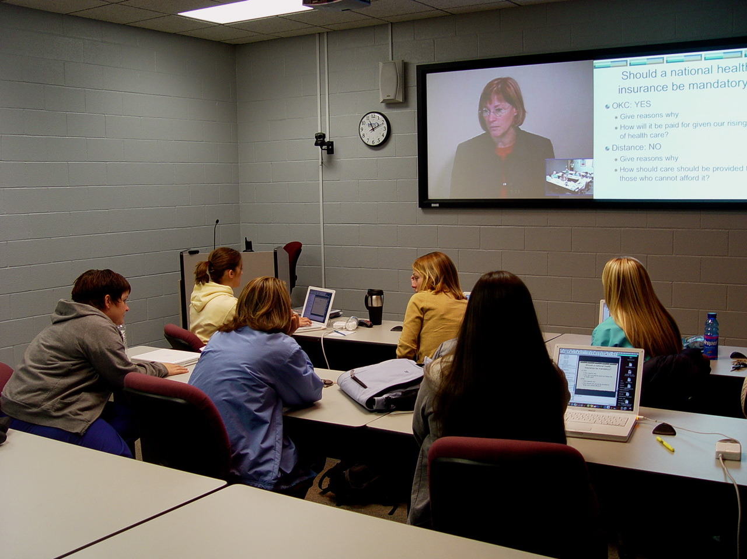
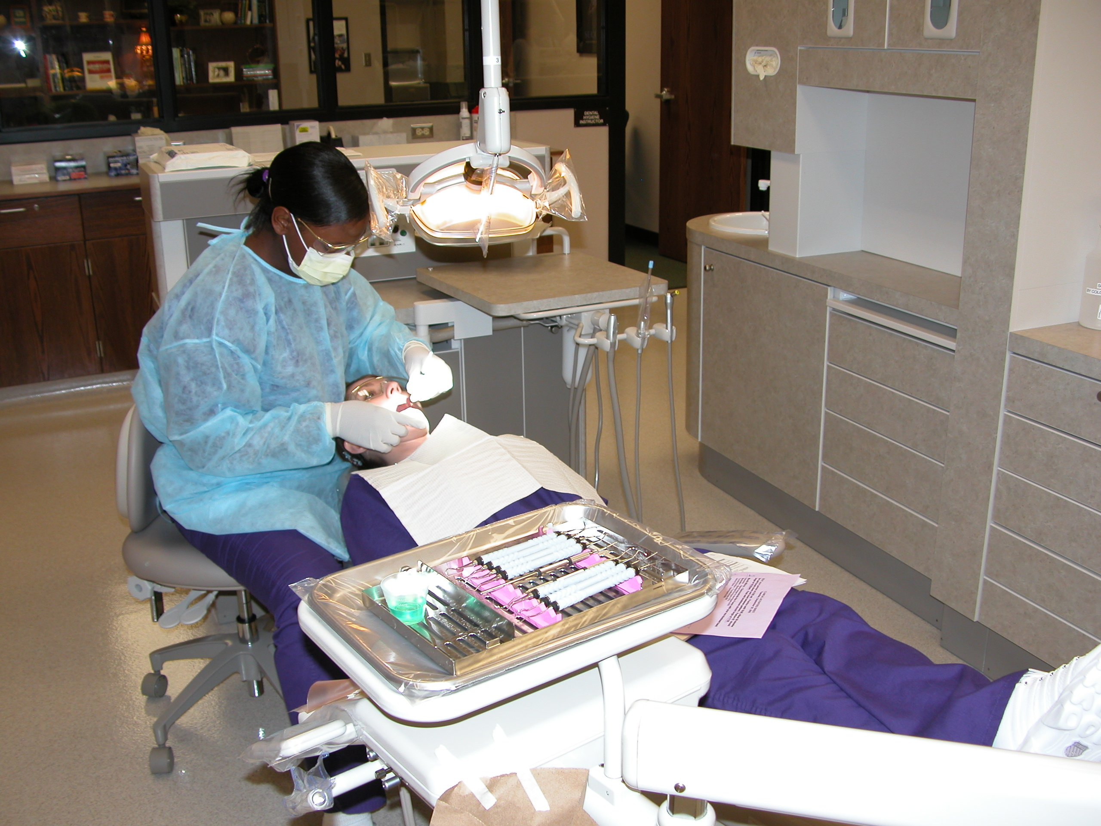
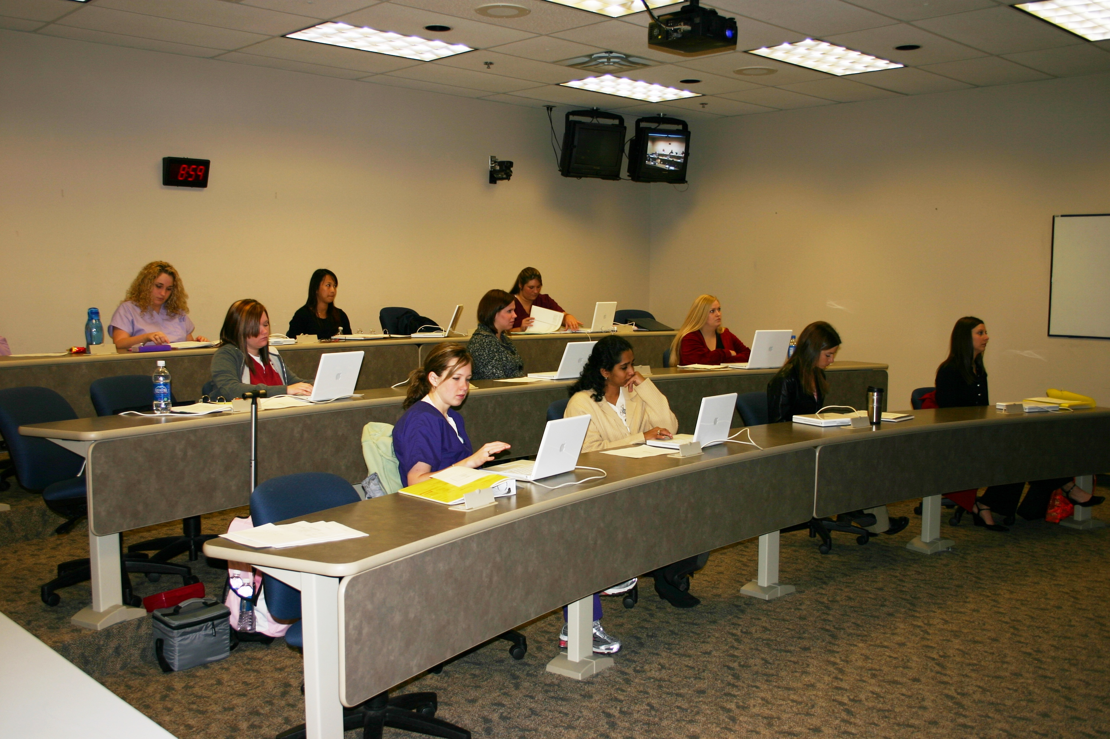
Distance Sites
WEATHERFORD: 6 Students Per Year
ARDMORE: 6 Students Per Year
BARTLESVILLE:
10 Students Per Year

Slide 9
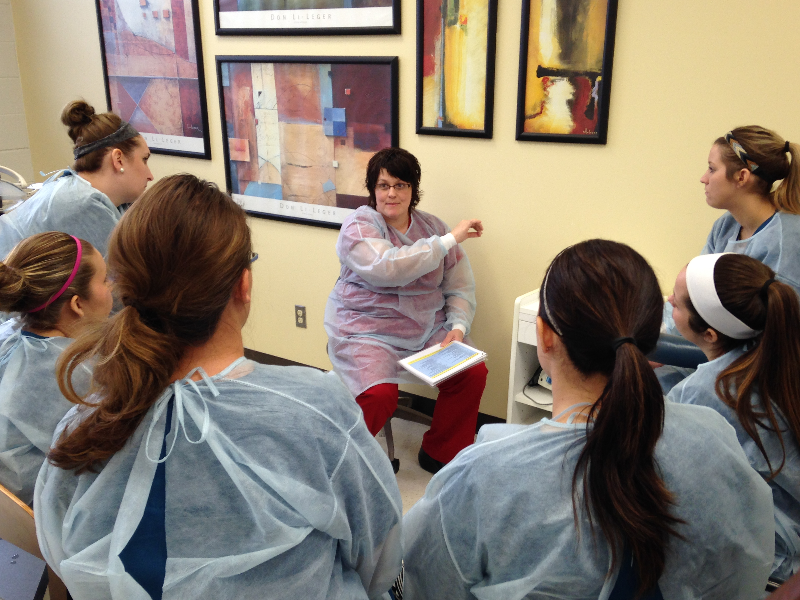
Distance Education
State-of-the-art laboratories, clinics, classrooms
Distance faculty have dual appointment.
OUCOD lectures delivered by interactive videoconferencing.

Slide 10
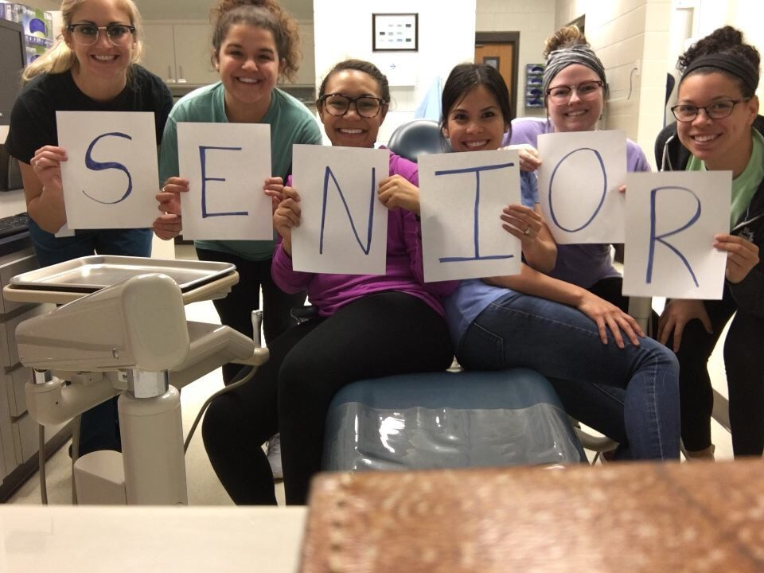
All Sites have the SAME…
Entry Requirements
Application/Selection Process
Professors
Educational Standards
Course Requirements
Graduation Requirements
Degree - BSDH

Slide 11
PROGRAM ENTRY REQUIREMENTS

Slide 12
Requirements
2 + 2 Program
Minimum 60 hours, including prerequisite courses
Minimum GPA 2.5 (on 4.0 scale)
ACT or SAT is Required

Slide 13
Requirements, cont.
Application/Fees (online)
40 Hours of RDH Observation (form online)
Personal Statement
Letters of Recommendation (2)

Slide 14
Requirements, cont.
FOUNDATIONAL COURSES
Must be completed by May, prior to start of school
PREREQUISITE COURSES
ALL prerequisite courses must be completed prior to entering the program

Slide 15
Foundational Courses
Human Physiology
Human Anatomy
Introduction to Microbiology (with Lab)
Introduction to Nutrition
Understanding Statistics
Principles of English Comp II
Elements of Psychology
General Chemistry (with Lab)

Slide 16
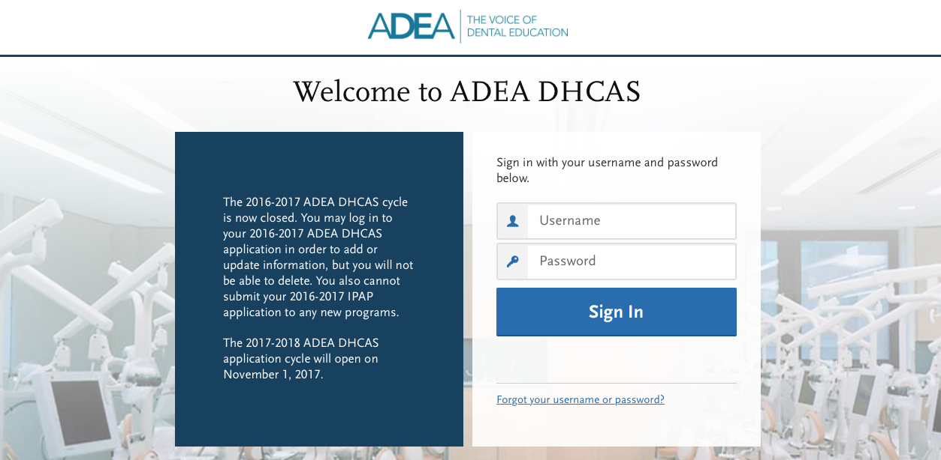
Timeline
Applications – OPEN NOVEMBER 1st
ADEA DHCAS (Primary Application)
OUHSC (Required Supplemental Application)
Applications – DEADLINE JANUARY 15th
ADEA DHCAS (Primary Application)
OUHSC –(Required Supplemental Application)
Accepted applicants are notified by mid-April

Slide 17
Selecting Sites for Application
Applicants can apply to one or more sites:
ARDMORE
BARTLESVILLE
OKLAHOMA CITY
WEATHERFORD
B
W
OKC
A

Slide 18
Selection is Competitive
Academic Score – Counts as 50%
Total GPA, Science GPA, ACT score and credit for the amount of Foundational Courses completed.
Interview Score - Counts as 50%
Total Interview scores from two interviewers

Slide 19
2019 Admissions Statistics
Total Number of Qualified Applicants | 147
Number Accepted | 46
Average Cumulative GPA | 3.47
Average ACT Score | 23
Average Age | 22
Notes:
122 last year!

Slide 20
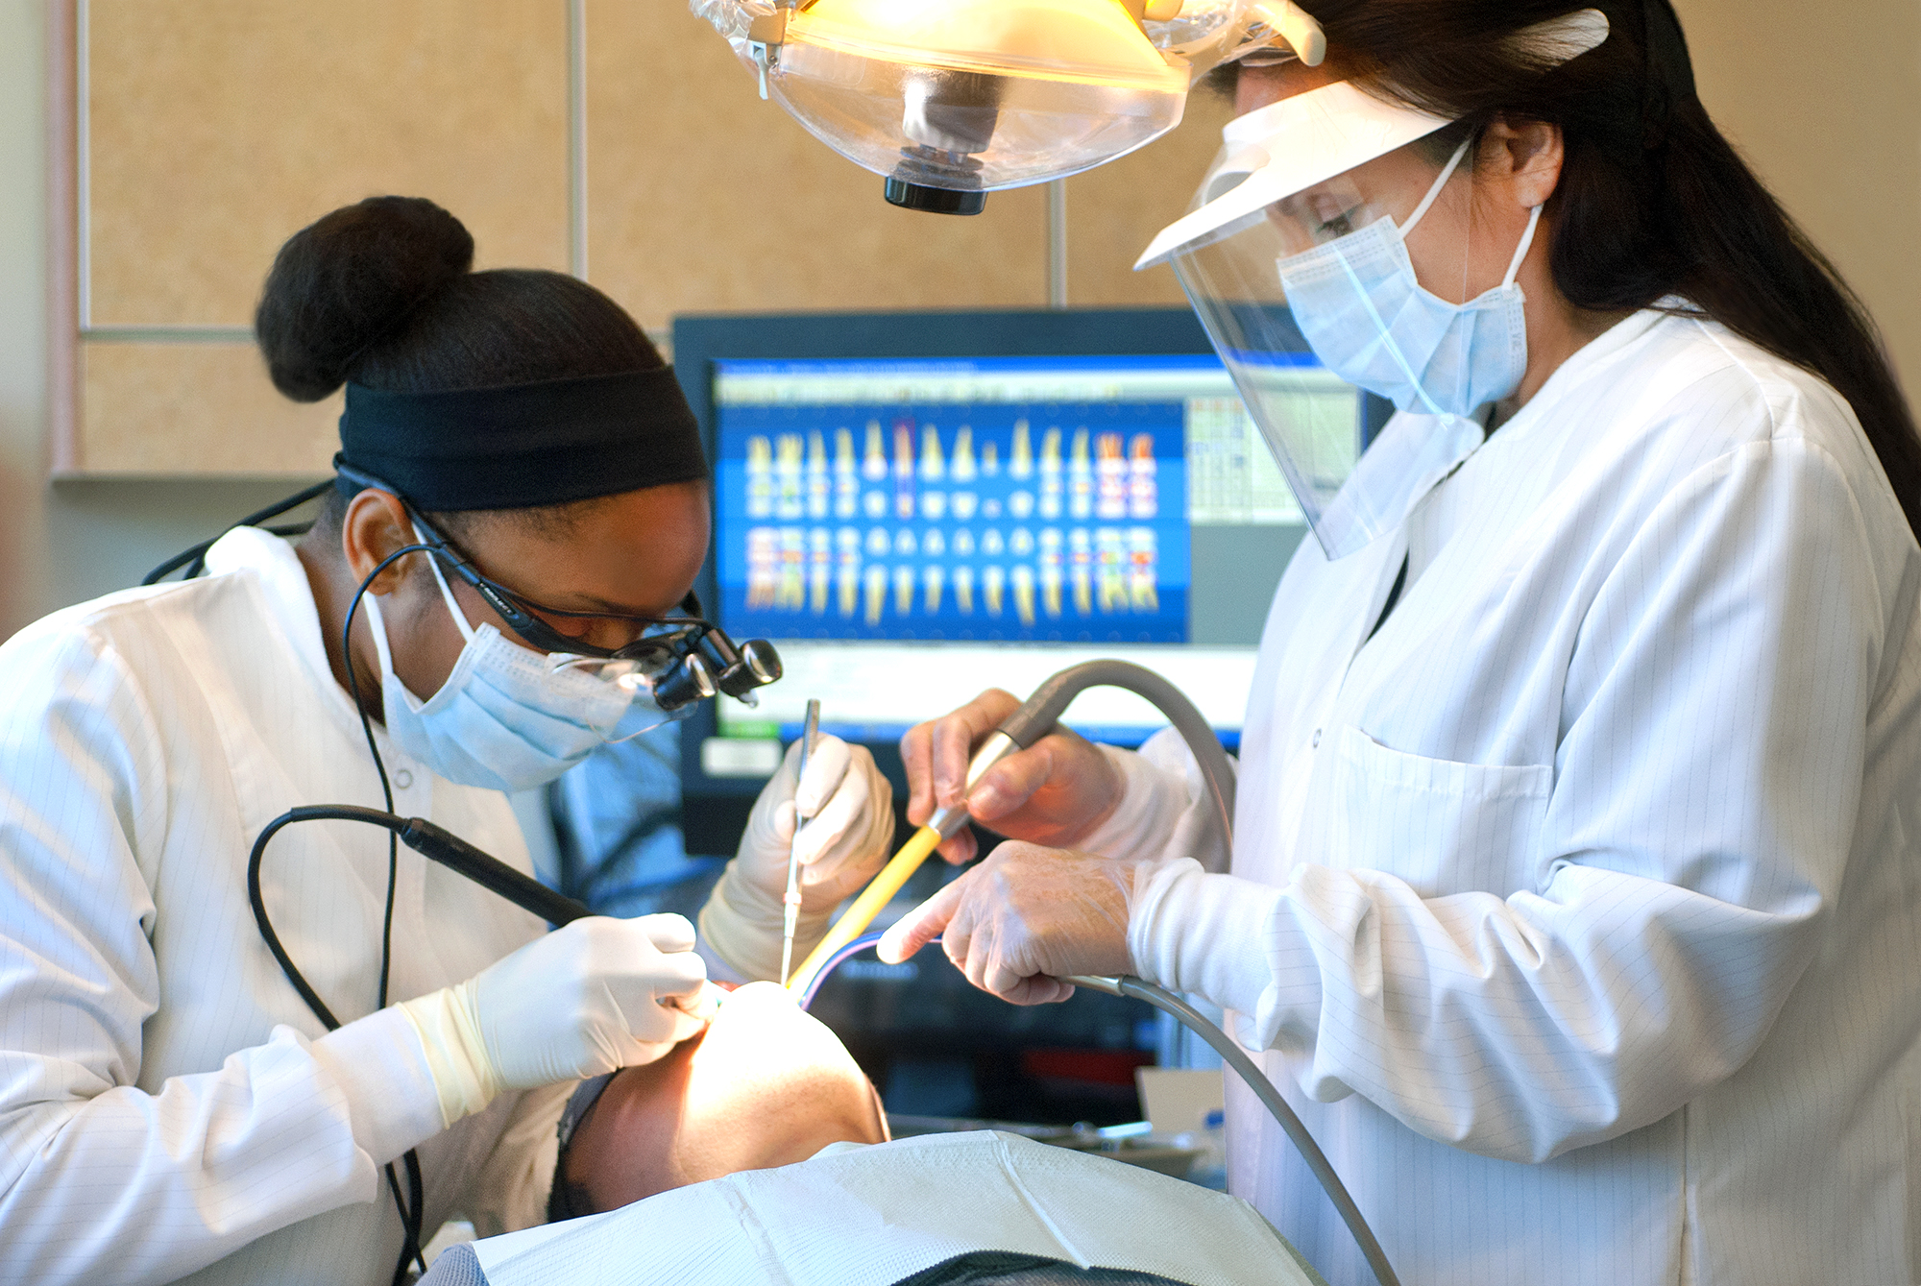
Qualities for Success
Academic Success
Critical Thinking
Compassion
Detail-Oriented
Dexterity
Physical Stamina
Interpersonal Skills

Slide 21
Advisement Information
Symposium Handout
Website: dentistry.ouhsc.edu

Slide 22
Admission Inquiries
Karen L. Rucker
Dental Hygiene Program
Student Program Coordinator
(405) 271-4435
karen-rucker@ouhsc.edu

